Slide 1

Engineering the Earth: making decisions under uncertainty
Modeling Uncertainty in the Earth Sciences
Jef Caers
Stanford University

Slide 2
The Thumb Tack Introduction
Making decision under uncertainty

Slide 3
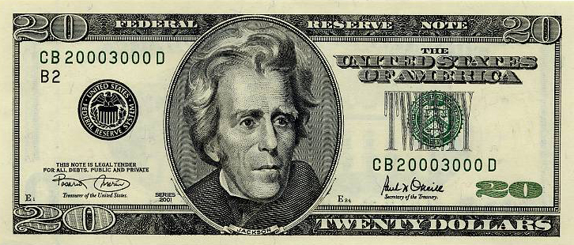
Decision time

Slide 4
Coin Flip
What is the probability of calling one flip of a coin correctly?
Is this an objectively assessed probability?

Slide 5
The Thumb Tack Toss
Now let’s try something with less general knowledge regarding the probabilities of outcomes.
Is the tack more likely to land pin-up or pin-down?

Slide 6
Investment Opportunity – Decision Rules
Opportunity to call the flip of the thumb tack
If you call it correctly, you win
Who wants to play?
If you call the toss
Correctly – Win $20
Otherwise – Nothing

Slide 7
Investment Rules – The Opportunity
VISA
MasterCard
The selected participant plays the game once.
The highest bidder plays – only one game.
$ 2 penalty to withdraw, opportunity goes to next highest bidder
Payment in cash only
Must be paid before the toss
I will toss the thumb tack.
The player calls: “Point up” or “Point down”.
If the call is correct, the player wins $20
If the call is incorrect, the player wins nothing
I keep the amount paid to play, regardless of the outcome.
Who wants to bid for the opportunity?
Let’s have an auction !

Slide 8
Auction types
Closed first price
Closed second price (Vickrey auction)
Open descending (Dutch auction)
Open ascending (English auction)

Slide 9
Certificate
This certificate grants the right to a single bet on the pin-up/pin-down toss in this lecture

Slide 10
Probability of winning
Correct Call
Probability = p
Note:
Probability is a “state of knowledge” (or lack thereof); not necessarily a property of the thumb tack!
Incorrect Call
Probability = 1 – p
If you assign “Correct call” the value “1” and incorrect call” the value “0”, what is then the Expected Value ? Variance ?
Notes:
Speaker’s Notes:
“Let’s examine the deal a little closer. Let’s zoom in on the part of the tree that shows the uncertainty.”
Ask the player what is the probability he or she assigns to winning. The probability must be at least 0.5. If the player says a number less than 0.5, ask their reasoning. The could, in the extreme, flip a coin to determine “pin up” or “pin down.” Then the deal would have 0.5 probability of being correct and paying the prize.
Write the player’s probability on the tree (on a slide or on a flip chart). Ask what is the probability of being incorrect? “That’s called the complementary probability. 1-p. That’s about as complicated as the math will get in this course.”

Slide 11
A decision tree helps organizing our thoughts
Decision
Uncertainty
Outcome
Net Profit
Correct Call
$ 20
$20 – X
p
Invest $ X
1 - p
Incorrect Call
0
– X
Don’t Invest
0
0
Decision
Uncertainty
Notes:
Speaker’s Notes:
“Now before I collect the $50 from our player, let’s diagram the problem. Again, I want to make sure that we both view the decision problem the same way.”
We will use a decision tree to view the problem.
Explain the square symbol for decision and then the circle for uncertainty. Then the outcome and the net profit. “We need to use ‘net profit’ when we’re evaluating the decision whether to invest or not.” Explain that the order of decisions and uncertainties must always be chronological, left to right.
Ask the player, “Is this the decision as you see it? Any differences?”

Slide 12
We define a decision as an “irrevocable” allocation of resources
We have a certificate acknowledging this first “decision” of the day.
Notes:
Speaker’s Notes: (EB Modified)
Collect the payment from the player.
Congratulate the player on “the first decision of the day.” “We define a decision as an ‘irrevocable’ allocation of resources. Cash you pay, people whose time you commit—anything that will be expensive if you change your mind.”
Give the player the certificate in exchange for the investment. Read what is printed on the certificate (what SDG printed): “entitling the player to call one flip of the thumbtack and, if correct, to win _____. Dated, _________.”
The certificate should have a blank gold seal attached if you have a notary seal (embossing machine) to use later on. If you don’t have the notary seal, then the certificate should not have a blank gold seal. Yet.
Put the money you collected into your pocket. Make sure everyone sees this. Ask “What to finance text books call this?” Answer: sunk cost.

Slide 13
Now that you own the deal, what is the least you would be willing to sell it for?
Decision
Uncertainty
Outcome
Correct Call
p
$ 20
Certainty Equivalent
(CE)
Invest X
1 - p
Incorrect Call
0
CE= the (sure/certain) amount of $ in your mind
to a situation that involves uncertainty
Don’t Invest
0
Remember to ignore the “sunk” cost $ X; that’s behind us now
Decisions are about the future, not the past !
Notes:
Speaker’s Notes:
“Now before I collect the $50 from our player, let’s diagram the problem. Again, I want to make sure that we both view the decision problem the same way.”
We will use a decision tree to view the problem.
Explain the square symbol for decision and then the circle for uncertainty. Then the outcome and the net profit. “We need to use ‘net profit’ when we’re evaluating the decision whether to invest or not.” Explain that the order of decisions and uncertainties must always be chronological, left to right.
Ask the player, “Is this the decision as you see it? Any differences?”

Slide 14
The difference between “expected value” and “certainty equivalent” reflects attitude toward risk
Risk Attitude
Expected Value
Certainty Equivalent
Risk Averse
Risk Neutral
Risk Preferring
Risk Premium = Expected Value – CE
This is a matter of preference; there is no “correct” risk attitude for an individual. There is nothing “expected” about expected value !
Notes:
Speaker’s Notes: (EB Modified)
DCW only: Use this chart to show the difference between expected value and certain equivalent. The vertical axis, in $, plots the certain equivalent. The horizontal line is the expected value. If the CE is less than the EV, the player is risk averse. The difference is called the risk premium. Most people are risk averse, especially when the consequences are large.

Slide 15
Note
Uncertainty: state of lack of knowledge or understanding
Risk: state of uncertainty that for some possibilities involve a loss

Slide 16
What if we could get some information regarding the toss before our investor decides what to call?
Would that be a good idea?
What if we could get perfect information?
What constitutes perfect information?
How much might that be worth?
How about imperfect information?

Slide 17
We can use the following equation to compute the value of information
VOI = Value with information – Value without information
Where,
VOI = Value of information
Value is the certainty equivalent, which equals the expected value if the decision maker is risk neutral.
Note: This method works for risk-neutral decision-makers or those with an exponential utility function. It is not true in general, but the above equation works well in practice.

Slide 18
What is the most our investor should pay for perfect information on the toss?
Decision
Uncertainty
Outcome
Correct Call
p
$ 20
Certainty Equivalent
(CE)
No Info
1 - p
Incorrect Call
0
VOPI = $ 20 - CE
Buy Info for $ Y
$ 20- Y
Decision
Uncertainty
Notes:
Speaker’s Notes:
“Now before I collect the $50 from our player, let’s diagram the problem. Again, I want to make sure that we both view the decision problem the same way.”
We will use a decision tree to view the problem.
Explain the square symbol for decision and then the circle for uncertainty. Then the outcome and the net profit. “We need to use ‘net profit’ when we’re evaluating the decision whether to invest or not.” Explain that the order of decisions and uncertainties must always be chronological, left to right.
Ask the player, “Is this the decision as you see it? Any differences?”

Slide 19
The value of “perfect” information
= the maximum value of any information gathering program
Information cannot have a negative value; you could always choose to ignore it
Reject any information-gathering proposals if they cost more than the value of perfect information

Slide 20
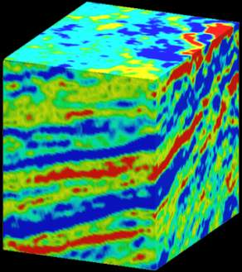
Perfect information is generally not available: here are imperfect sources
Experiments—5 trial flips of the tack
Geophysical Surveys
Experts
Mathematical models
Notes:
Speaker’s Notes:
Before you show this slide, ask participants the question in the title. Have them suggest sources of information. “Are these sources ‘perfect?’ How do we usually determine whether or not it is worthwhile to gather additional information before making a decision? Decision analysis provides an explicit, quantitative way to determine how much to spend for information that could improve a decision.
If someone suggests a “model,” you could pick up the pie-tin tack. Say, “And if you had a model of how this flips in the air and bounces on the surface, you could change parameters in the model, Right?” Pull the “pin” out to it’s full length. (Laugh)
After the discussion, turn the projector on and show the slide.
OPTIONAL: Offer the player 5 flips for $1 ($5 if you’re using a gold coin). If he or she accepts, flip a second tack five times, keeping track of pin up and pin down. If you’re lucky, you’ll get 2 and 2. You can then ask how the player will use the information if the outcome of the next trial flip is “pin up” or “pin down.”

Slide 21
Value of imperfect information
Depends on the prior state if knowledge
Depends on the decision one would like to make
Depends on the “reliability” of the information source
Relationship between the information source and the unknown event

Slide 22
What is your call?
Point up?
Point down?
Notes:
Speaker’s Notes:
“Now we’re finally ready to finish the game. Ask the class, “Did the player make a good decision to enter this game? Is he/she guaranteed a good outcome?”
“Okay, what is your call, ‘Pin up’ or ‘Pin down?’”
Place the pie-tin tack in the position the player specifies, and then quickly reveal the tack. Applaud if the player is correct—award the prize.
If the player is wrong, show and express concern. “I’m sorry; I wish you had won. However, you’ve helped us all learn an important lesson. Even though you made a great decision, you had a bad outcome.” Stamp the certificate with the “Bad Outcome” rubber stamp. We all thank you for teaching this lesson—applaud the player.

Slide 23
Making good decisions may not lead to good outcomes
Decisions with Certainty
Decisions with Uncertainty
Correct
Invest
Correct
Invest
Incorrect
Don’t Invest
Don’t Invest
Good decisions guarantee good outcomes.
Good decisions do not guarantee good outcomes.
The goal of decision analysis is to make the best decisions in the face of uncertainty.
Notes:
Speaker’s Notes:
The slide says it all.

Slide 24
Take-aways
A decision is an irrevocable allocation of resources, not a mental commitment.
Ignore sunk costs.
Ignore past events and non-recoverable loss of resources
The only decisions you make are about the future
Probability as a state of knowledge
Risk attitudes
Certainty equivalent vs expected value
Value-of-Information

Slide 25
Take-aways for what comes next
In geo-engineering: decisions are much more complex
Multiple, possibly conflicting objectives
“Events” are not simply outcome of tosses, they are possible configurations of the subsurface whose modeling is complex
Information gathering:
Costly
Multiple sources
Uncertainty
Value of information assessment is critical but difficult

Slide 26
Decision making process
Making decision under uncertainty

Slide 27
Field of decision analysis
Professor Ron Howard, 1966
“systematic procedure for transforming opaque decision problems into transparent decision problems by a sequence of transparent steps”

Slide 28
Decisions
“Many are stubborn in pursuit of the path they have chosen,
few in pursuit of the goal.”
Neitzsche
As engineering/scientists we tend to obsess with
How-to-do – the recipe
instead of
What-should-we-be-doing-and-why
Use the elevator pitch approach

Slide 29
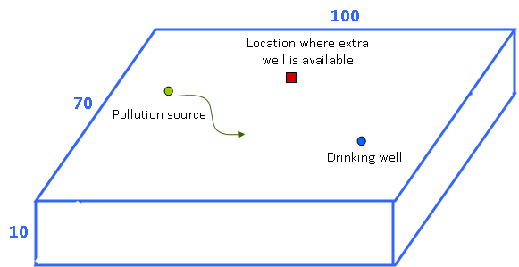
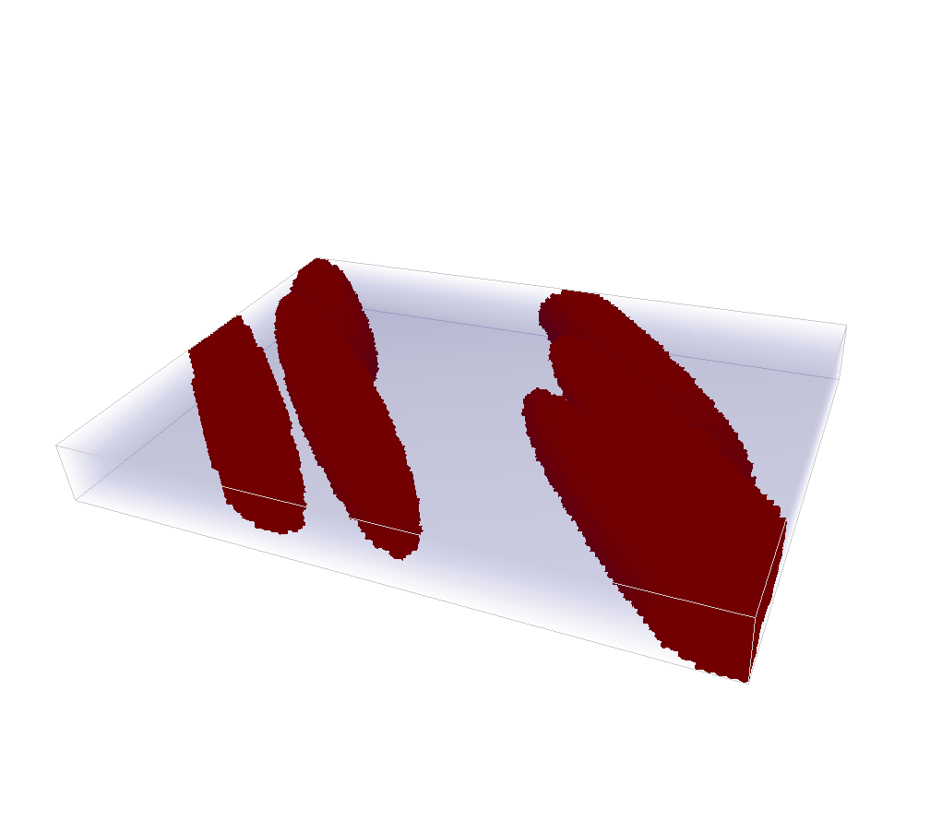
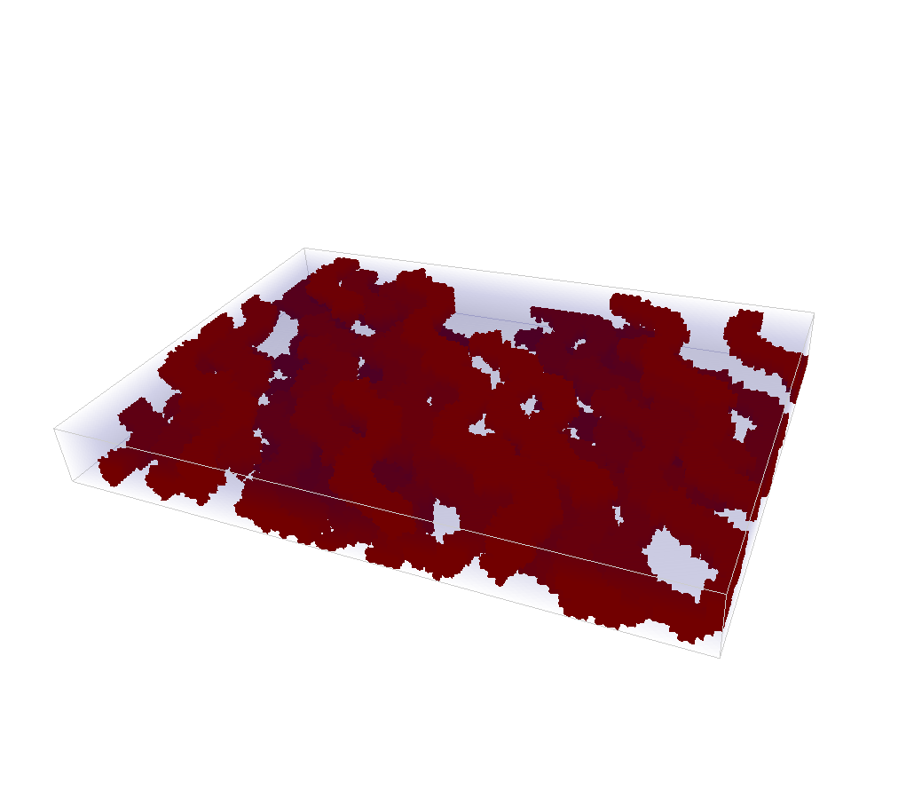
An example decision problem
?
Uncertain orientation
Uncertain geological scenario

Slide 30
Important: language/nomenclature
Decisions: conscious, irrevocable allocation of resources to achieve desired objectives
Alternatives: mutually exclusive choices to be decided on
Objectives: criteria used to judge alternatives
Attributes: quantitative measures of how an alternative achieves an objective
Payoffs: outcomes or consequences of each alternative for each objective
Preferences: the relative desirability between multiple objectives

Slide 31
Objectives: “value” tree
Maximize satisfaction
of local population
Minimize
Economic
Interruption
Minimize Tax
Collection
Improve
Environment
Improve Welfare
Maximize
Population
health
Maximize
Population
Safety
Minimize
industrial
pollution
Maximize
ecosystem
protection
Attributes and weights given to each attribute

Slide 32
Objectives
Evaluation concerns or higher level values drive setting objectives
Fundamental objectives: basic reason why the decision is important, ask “Why is it important?” Answer: “because it is”
Means objectives: possible ways of achieving fundamental objectives
Objectives scales

Slide 33
Measure the achievement of an objective
Natural scales
Constructed scales: e.g. population safety
1 = no safety
2 = some safety but existing violent crime such as homicide
3 = no violent crime but excessive theft and burglary
4 = minor petty theft and vandalism
5 = no crime

Slide 34
Estimating payoffs: pay-off matrix
alternatives
 | Detailed clean-up | Clean-up | Partial clean-up | Do not clean up
Tax collection (million $) | 12 | 10 | 8 | 18
Industrial pollution (ppm/area) | 25 | 30 | 200 | 500
Ecosystem protection (1-5) | 5 | 4 | 2 | 1
Population health (1-5) | 5 | 5 | 2 | 2
Economic interruption (days) | 500 | 365 | 50 | 0
Objectives

Slide 35
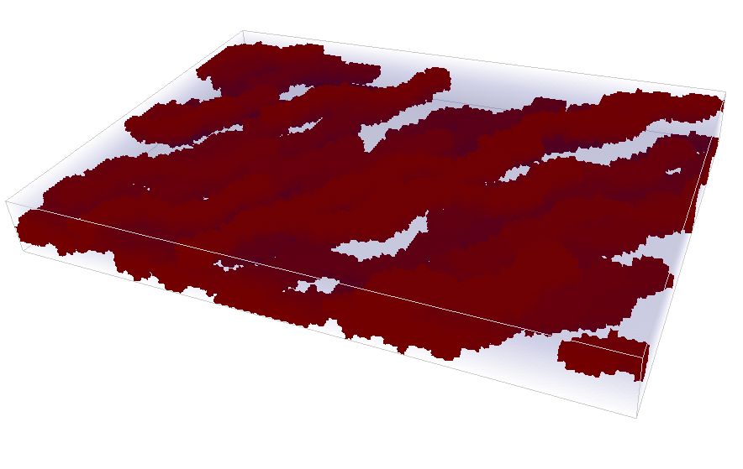
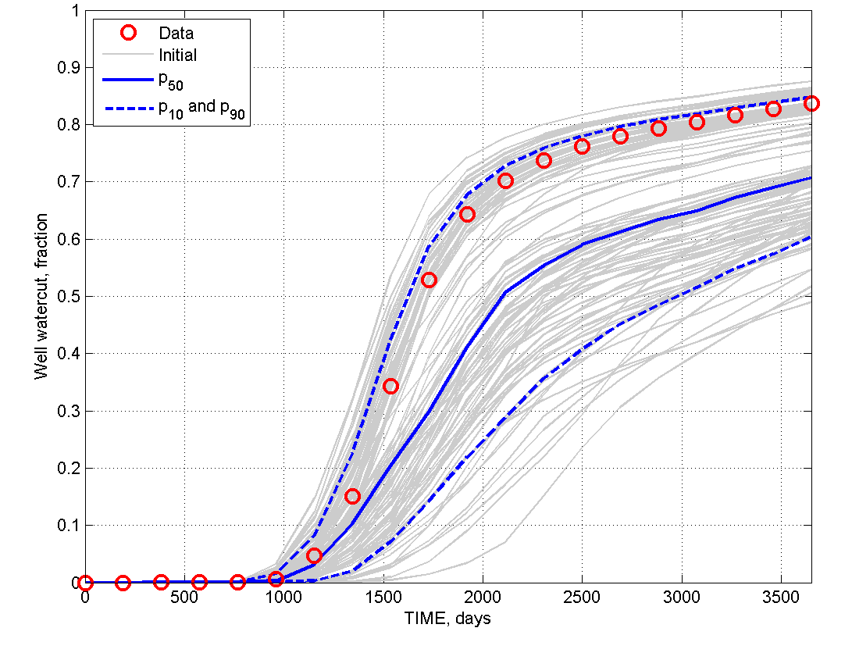
How to get pay-offs ?
Calculate expected
costs / profits
Build models
Get responses

Slide 36
Estimating payoffs: pay-off matrix
alternatives
 | Detailed clean-up | Clean-up | Partial clean-up | Do not clean up
Tax collection (million $) | 12 | 10 | 8 | 18
Industrial pollution (ppm/area) | 25 | 30 | 200 | 500
Ecosystem protection (1-5) | 5 | 4 | 2 | 1
Population health (1-5) | 5 | 5 | 2 | 2
Economic interruption (days) | 500 | 365 | 50 | 0
Objectives
Problem: attributes are on different scale

Slide 37
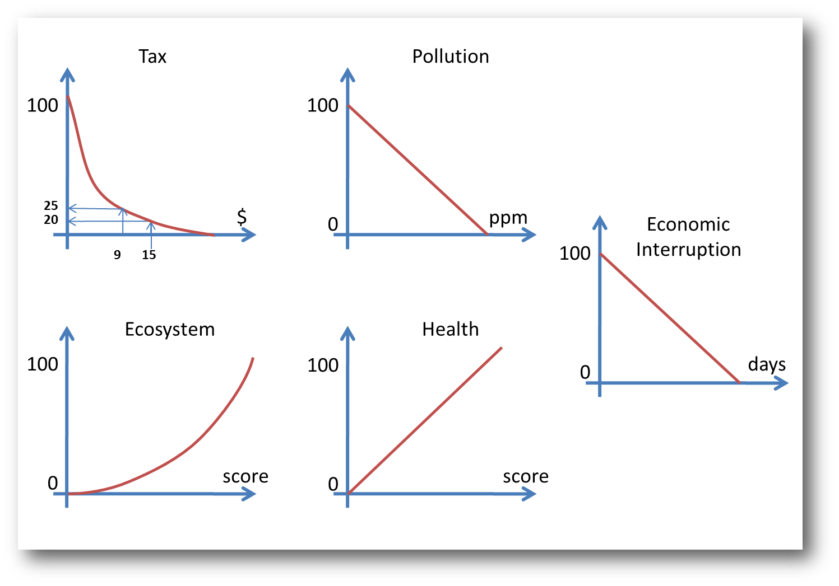
Preference and value functions

Slide 38
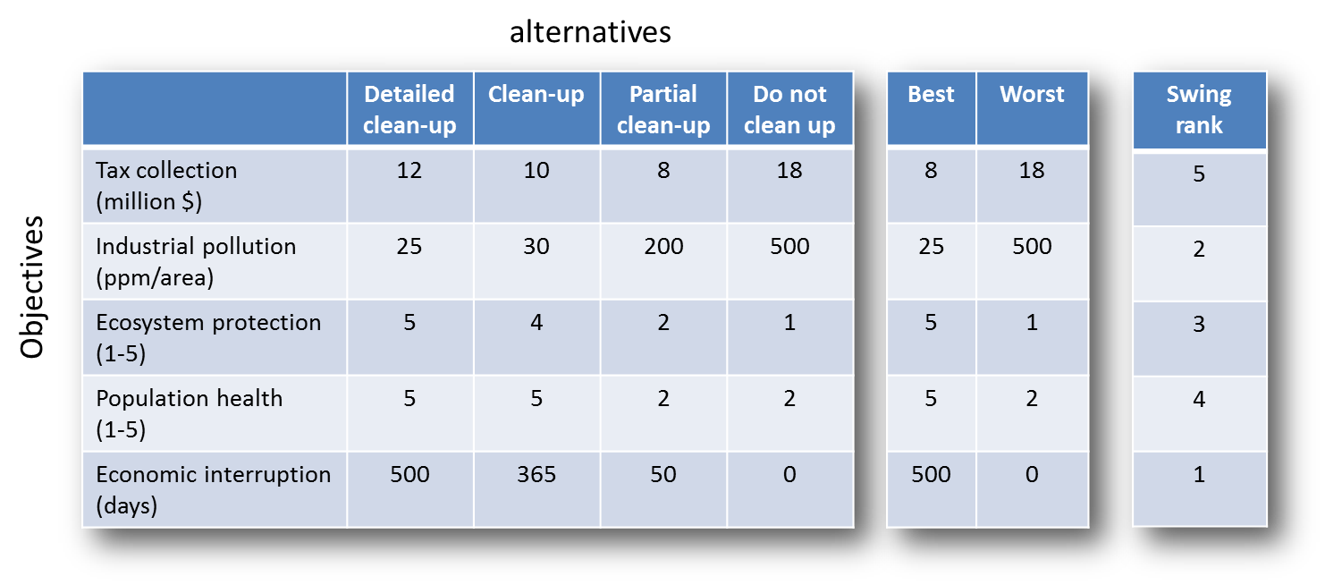
Swing weighting
Objectives should be weighted relative to how well they discriminate alternatives, they should not be weighted in an absolute measure of importance

Slide 39
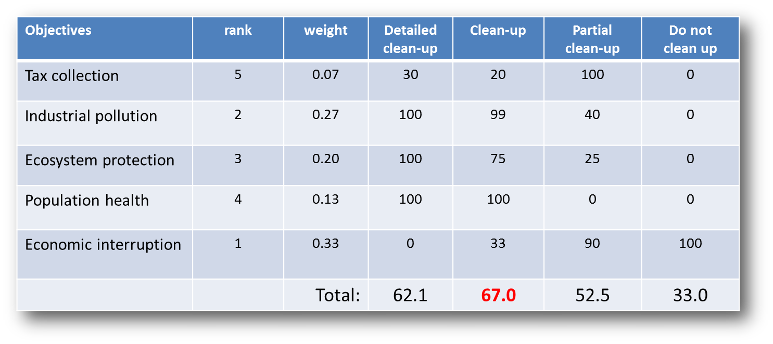
Scoring

Slide 40
Trade-offs
Objectives | rank | weight | Detailed clean-up | Clean-up | Partial clean-up | Do not clean up
Tax collection | 5 | 0.07 | 30 | 20 | 100 | 0
Economic interruption | 1 | 0.33 | 0 | 33 | 90 | 100
Industrial pollution | 2 | 0.27 | 100 | 99 | 40 | 0
Ecosystem protection | 3 | 0.20 | 100 | 75 | 25 | 0
Population health | 4 | 0.13 | 100 | 100 | 0 | 0
Objectives | Detailed clean-up | Clean-up | Partial clean-up | Do not clean up
Return / $ benefit | 2.1 | 12.3 | 36.7 | 33
Risk / $ cost | 60 | 54.7 | 15.8 | 0

Slide 41
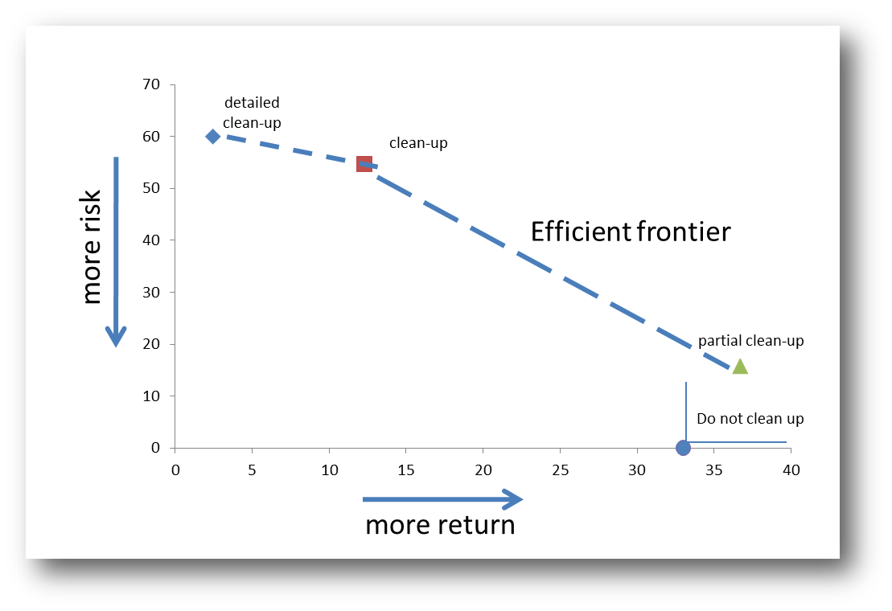
Trade-offs

Slide 42
Sensitivity analysis
Making decision under uncertainty

Slide 43
Sensitivity analysis
Example parameters
Variogram
Random numbers
Boundary condition
Initial condition
Example response
Decision
Earth Temperature
Reservoir pressure
Earth model
Deterministic
Modeling
Function
Input
Parameters
Output
Response
Δ input
Δ output
Example functions
Flow simulation
GCM
Stochastic simulation
Decision model

Slide 44
Importance of sensitivity analysis
Aim: what is important about the decision making process are not the absolute numbers but to figure out what are the most important/sensitive parameters to the decision making process
There are three kind of input “parameters”
Subjective assessment of how we perceive value
Weights
Value functions
Models used to calculate payoffs (such as Earth models)
Uncertain Earth models
Control parameters (e.g. of engineering facilities)
Which alternatives we specify

Slide 45
Tornado charts: single objective
Drinking water produced
million gallons/yr
-5
0
+5
Aquifer volume
Grain size
Proportion shale
Depth water table
Orientation sand channels
Single output/payoff versus multiple inputs

Slide 46
Multiple objectives
Score for each alternative
Weight of objective “minimize economic interruption”

Slide 47
Monte Carlo simulation: multiple objectives, multiple uncertainties
Tornado charts ignore dependency as well as probabilistic prior information of input variables
Monte Carlo simulation overcomes this difference but may be more costly particularly with large models

Slide 48
The big Monte Carlo simulation
uncertain
uncertain
certain or uncertain
uncertain
Spatial
Input parameters
Spatial
Stochastic
model
Physical model
Forecast and decision model
response
uncertain
Physical
input parameters
Datasets
uncertain
Raw
observations
uncertain/error

Slide 49
What can be uncertain?
The datasets used to build models
The interpretation of the subsurface geological setting
The location of connected zones
The hydrogeological model (initial and boundary conditions)
The contaminant transport model (bio/chemical properties)
The decision model

Slide 50
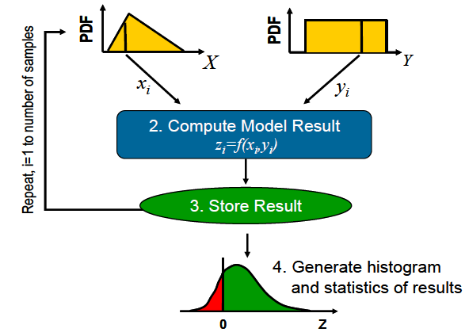
Monte Carlo simulation with multiple variables
Monte Carlo simulation
Any variable, any CDF
Any type of dependency
Any response function
But may be
Inefficient !

Slide 51
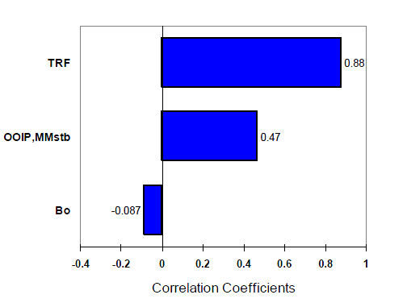
Example result of a Monte Carlo simulation
Many possible ways of summarizing the result of a Monte Carlo simulation,
for example use the correlation coefficient between the input sample data
for a variable and the corresponding output result
Correlation with total oil recovered
( TRF=Tertiary recovery factor)

Slide 52
Structuring decisions: decision trees
Making decision under uncertainty

Slide 53
Decision trees
recharge
at location 1
(uncertain)
channel
orientation
$ value 1
$ value 2
no
recharge
$ value 2
recharge
at location 2

Slide 54
Example

Slide 55
Dependent and independent events

Slide 56
Solving decision trees
Select a rightmost node that has no successors.
Determine the expected payoff associated with the node.
If it is a decision node: select the decision with highest expected value
If it is a chance node: calculate its expected value
Replace the node with its expected value
Go back to step 1 and continue until you arrive at the first decision node.

Slide 57
Example
Clean-up cost = $15M
Law-suit cost = $50M
?
Uncertain orientation
Uncertain geological scenario

Slide 58
Example

Slide 59
Example

Slide 60
Example
Clean
-15 cost of clean-up
channels
-34.3 = -0.4×44.5 - 0.6×27.5
0.5
Do not clean
sand bars
-8.6 = -0.4×20 - 0.6×1
0.5

Slide 61
Result
Clean
-15 cost of clean-up
Do not clean
-21.5 = -0.5×34.3 - 0.5×8.6

Slide 62
Sensitivity analysis
Sensitivity on prior probability
for geological scenario
Sensitivity on cost

Slide 63
Probability sensitivity: maintain relative likelihood
Three probabilities p₁, p₂, p₃
One-way sensitivity on p₁
Similar for p₂, p₃
p₂ = (1- p₁)* k₂
k₂=p₂/( p₂+ p₃)
p₃ = (1- p₁)* k₃
k₃=p₃/( p₂+ p₃)

Slide 64
Risk profiles (not in book)
Making decision under uncertainty

Slide 65
Risk profile
Using expected value for comparing alternatives works when the decision game is “played in the long run”
What are example decision that don’t fall under this?
Some alternatives are more risky than others
Risk profile = set of end-node payoffs and their associated uncertainties
For the optimal decision
For any decision non-optimal under expected value

Slide 66
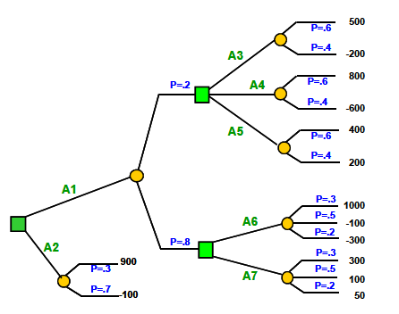
Example decision tree
Solution: chose A1 / A5 / A6

Slide 67
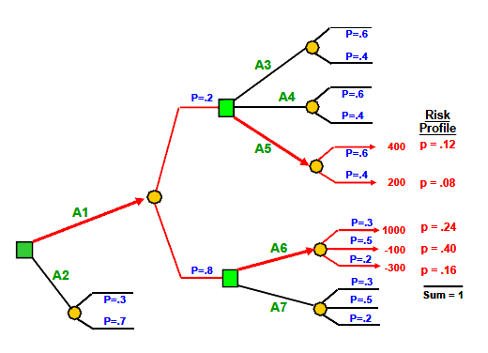
Example

Slide 68
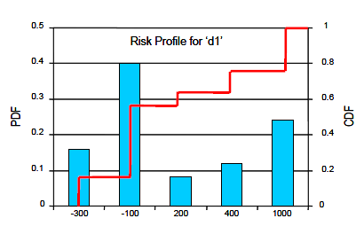
Risk profile for decision tree
alternatives
This contains much more information than an expected value

Slide 69
Decision trees and VOI
Making decision under uncertainty

Slide 70
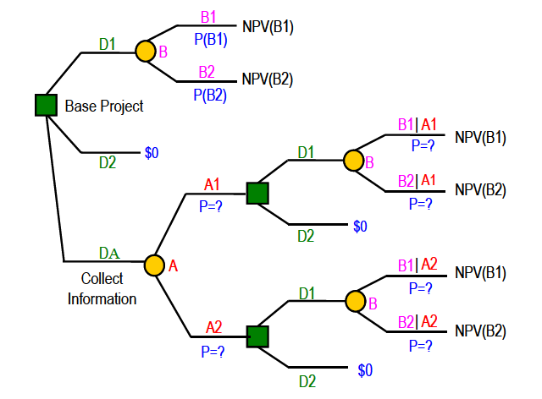
Example

